Slide 1
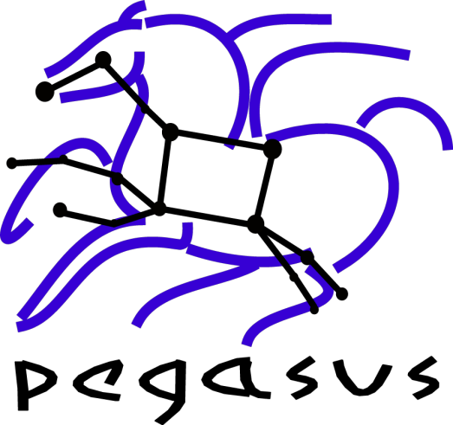
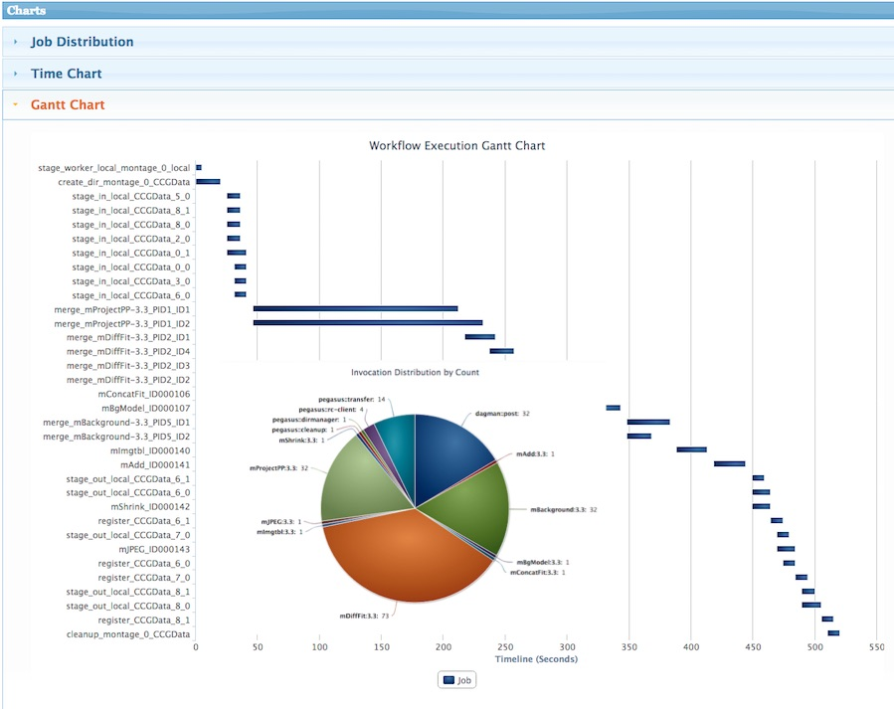
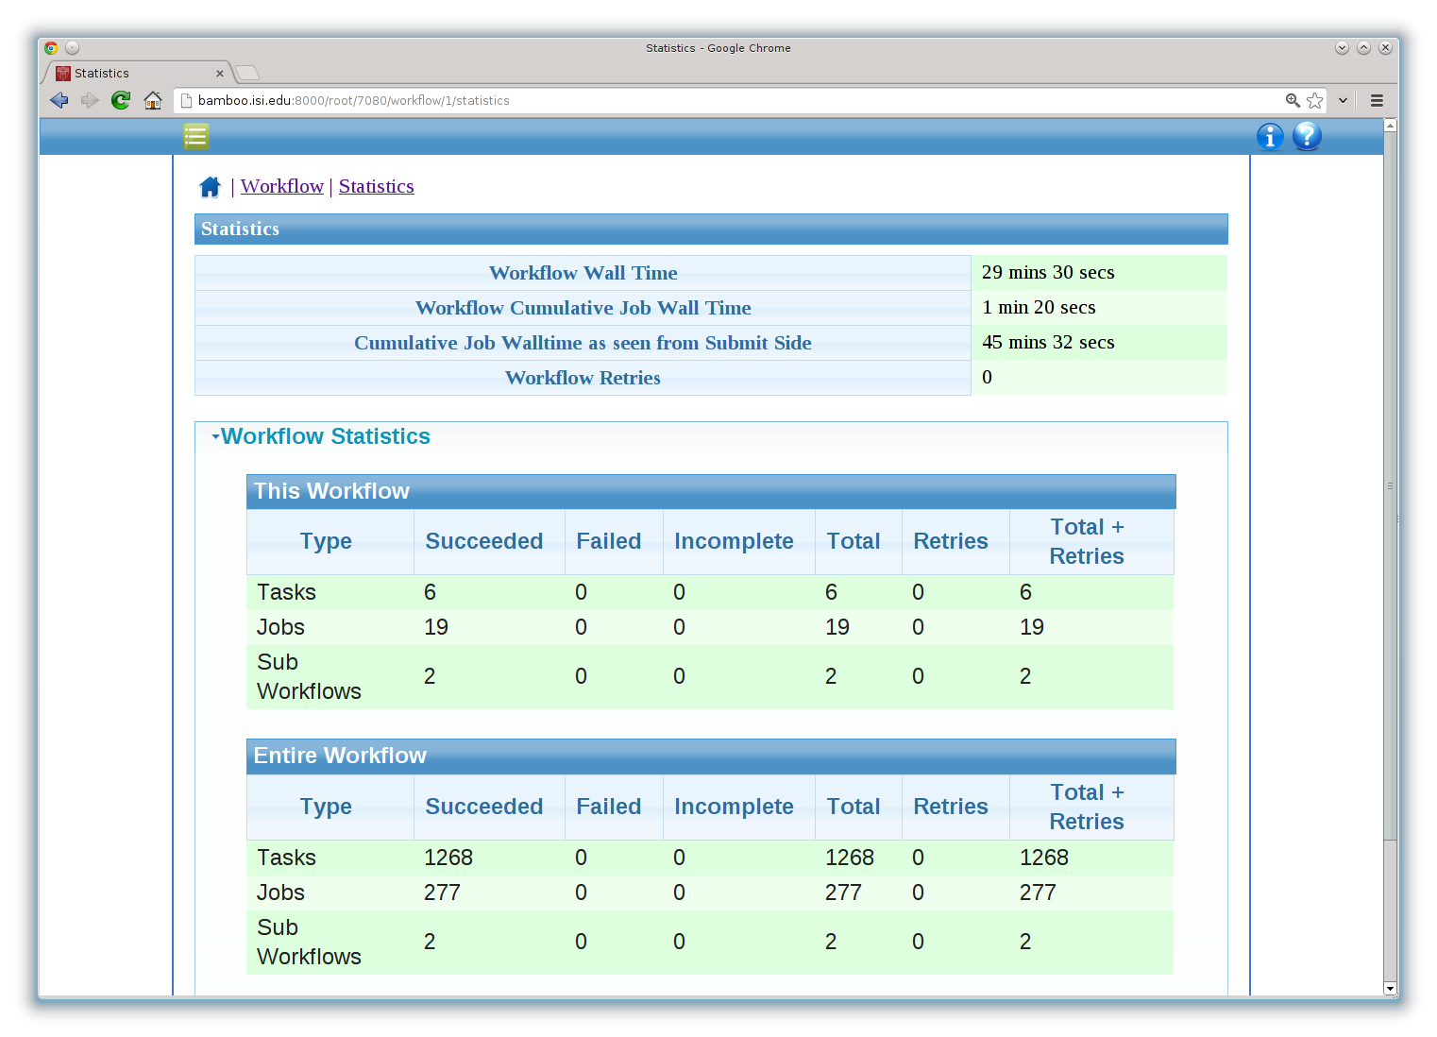
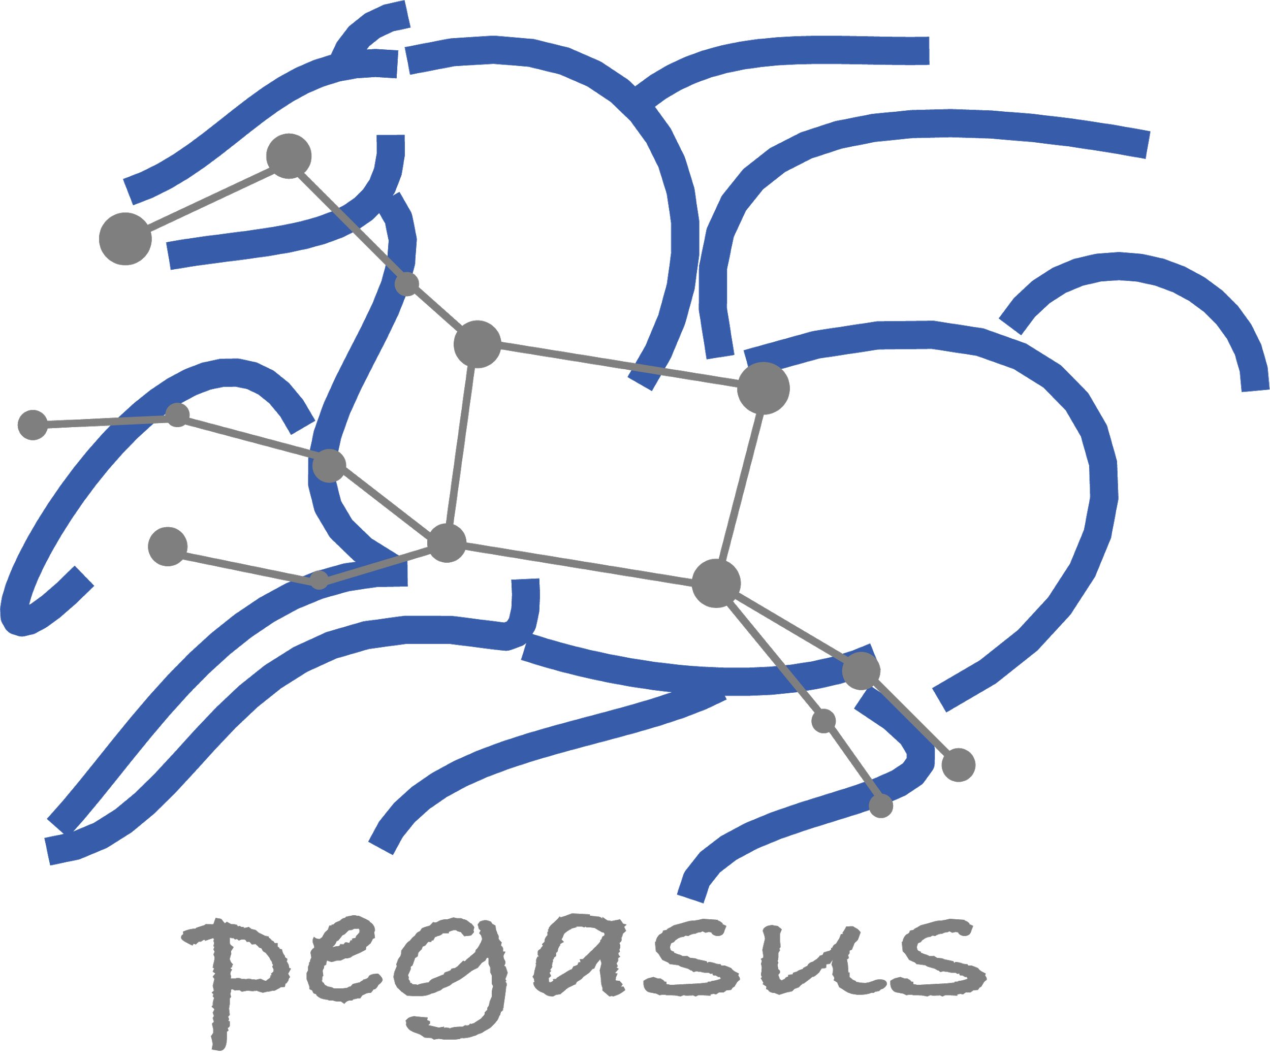
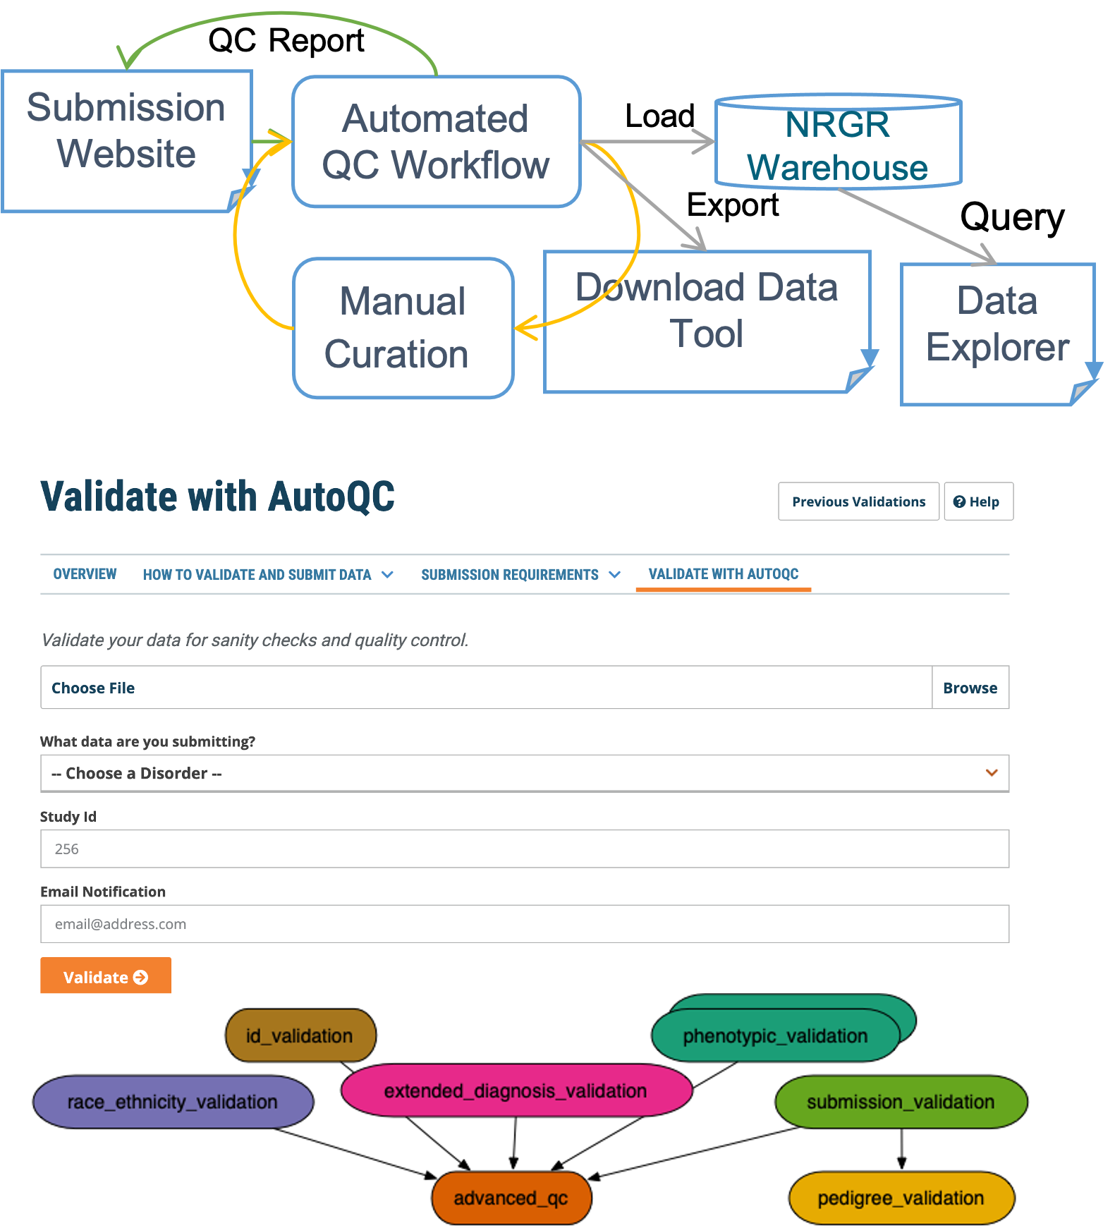
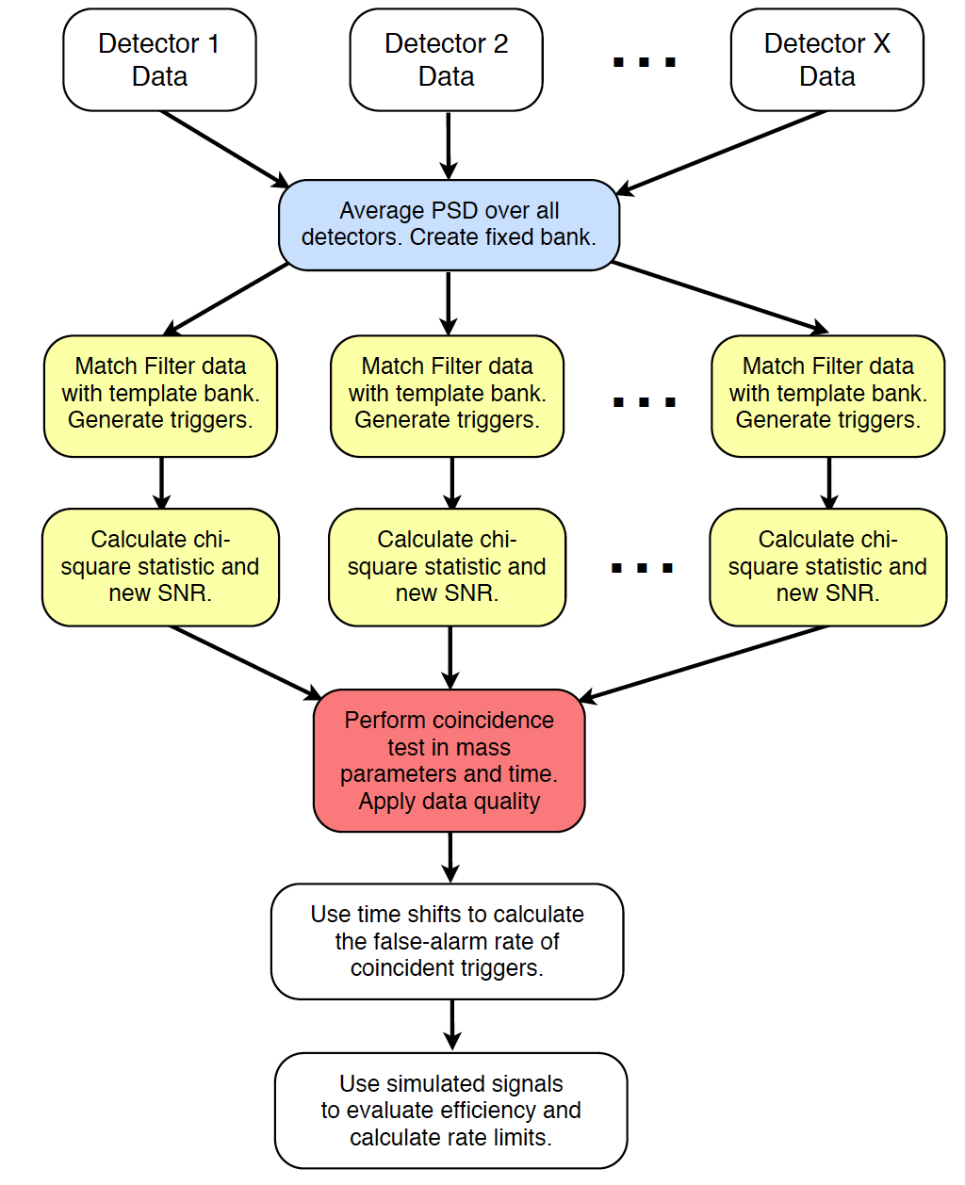
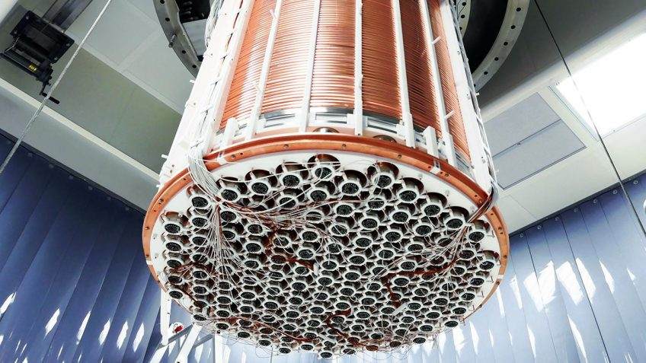
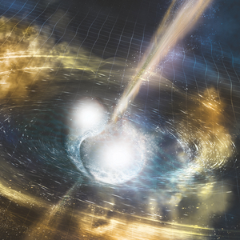
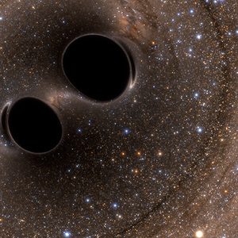
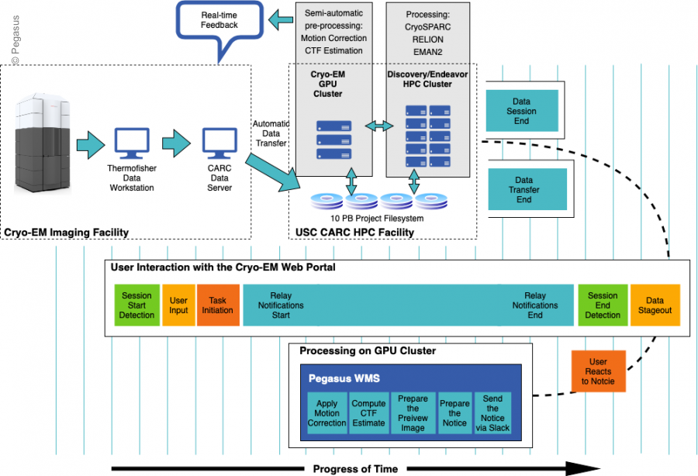
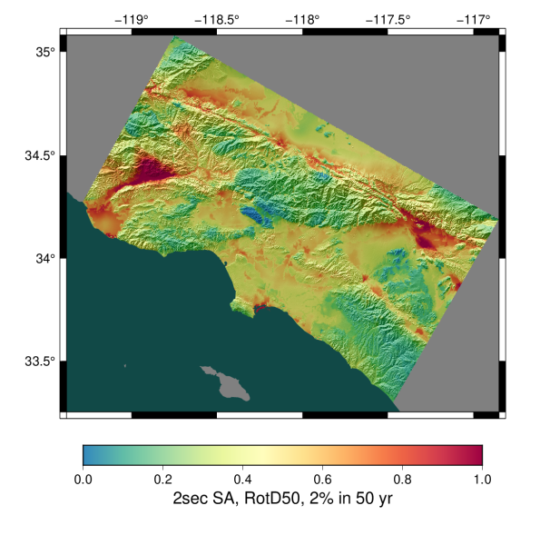

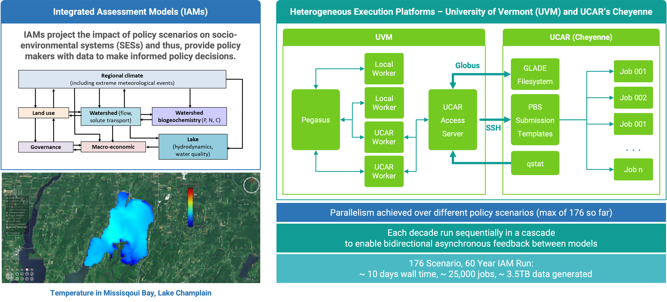
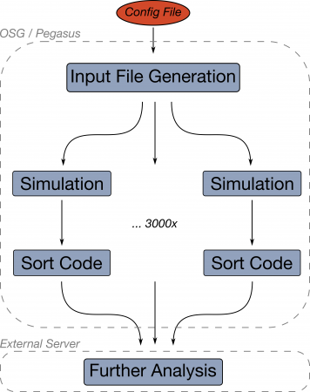
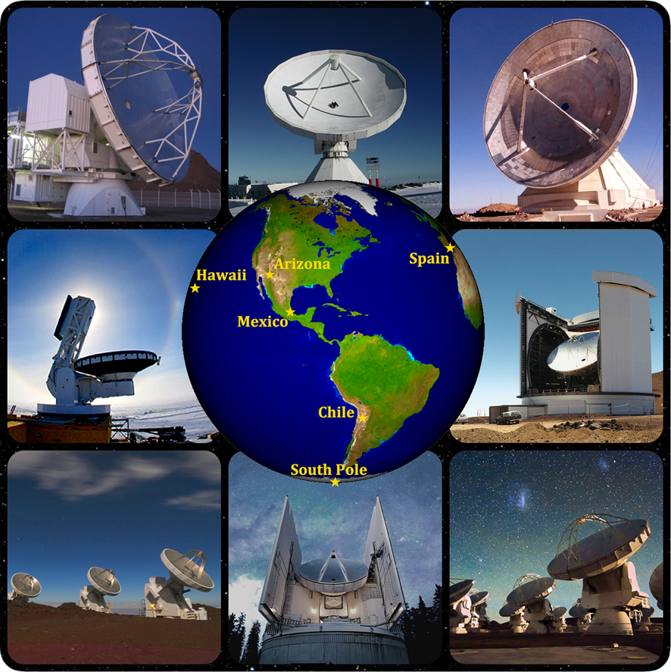
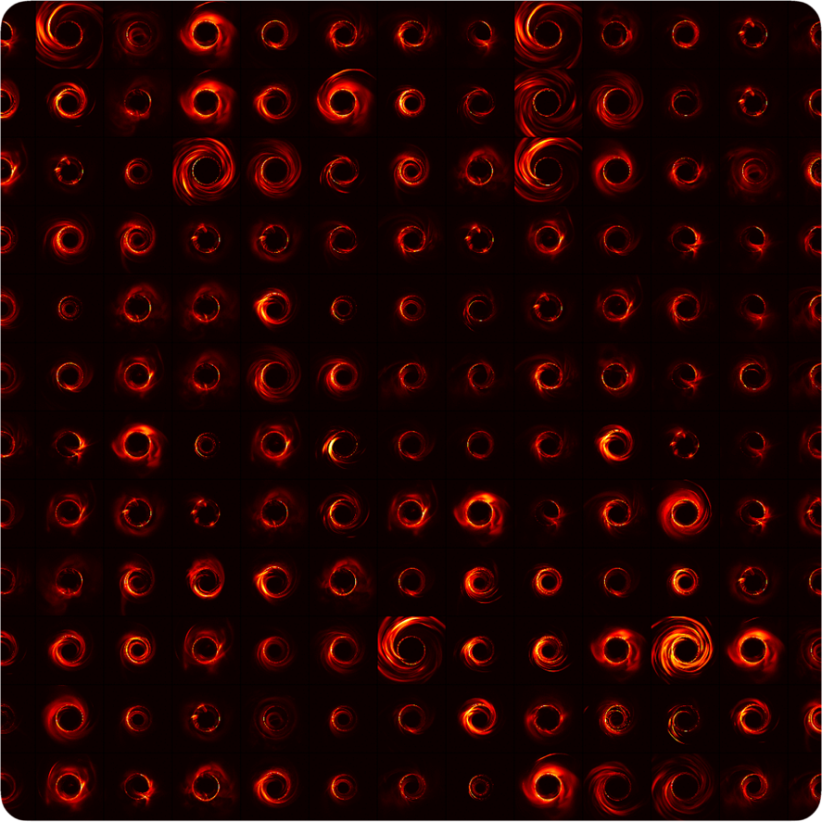
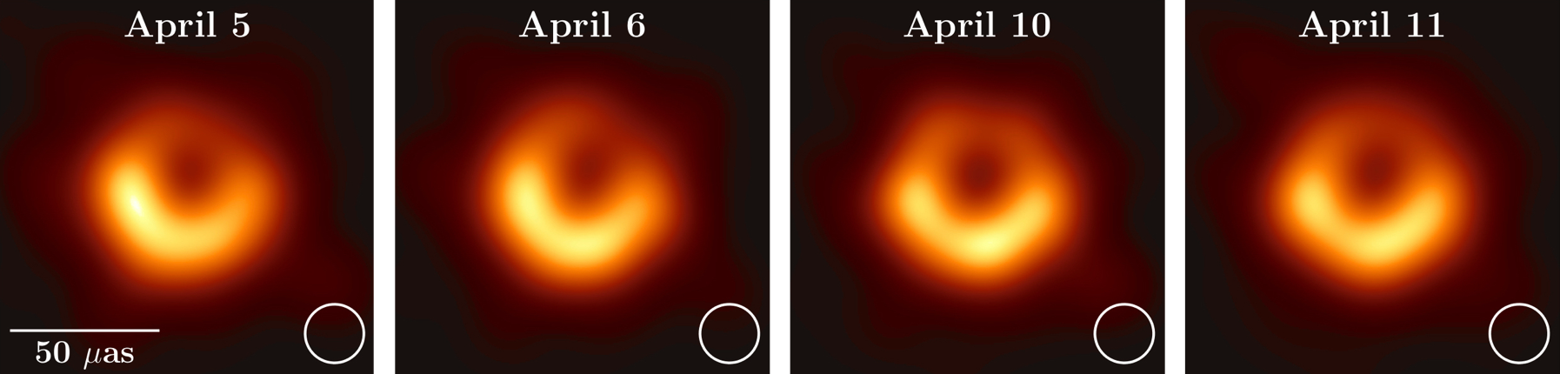

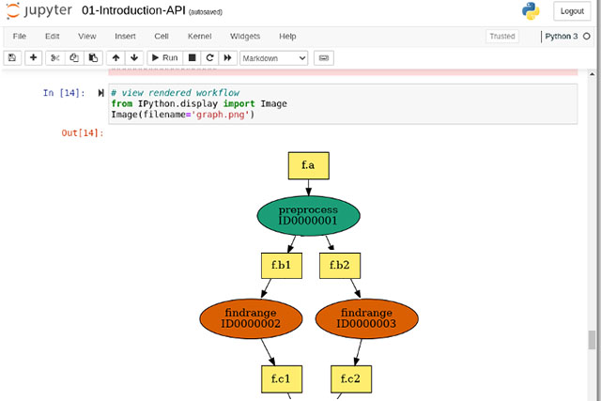
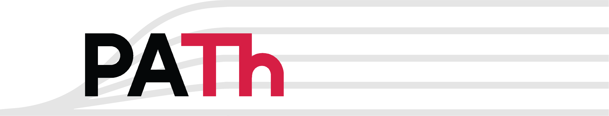
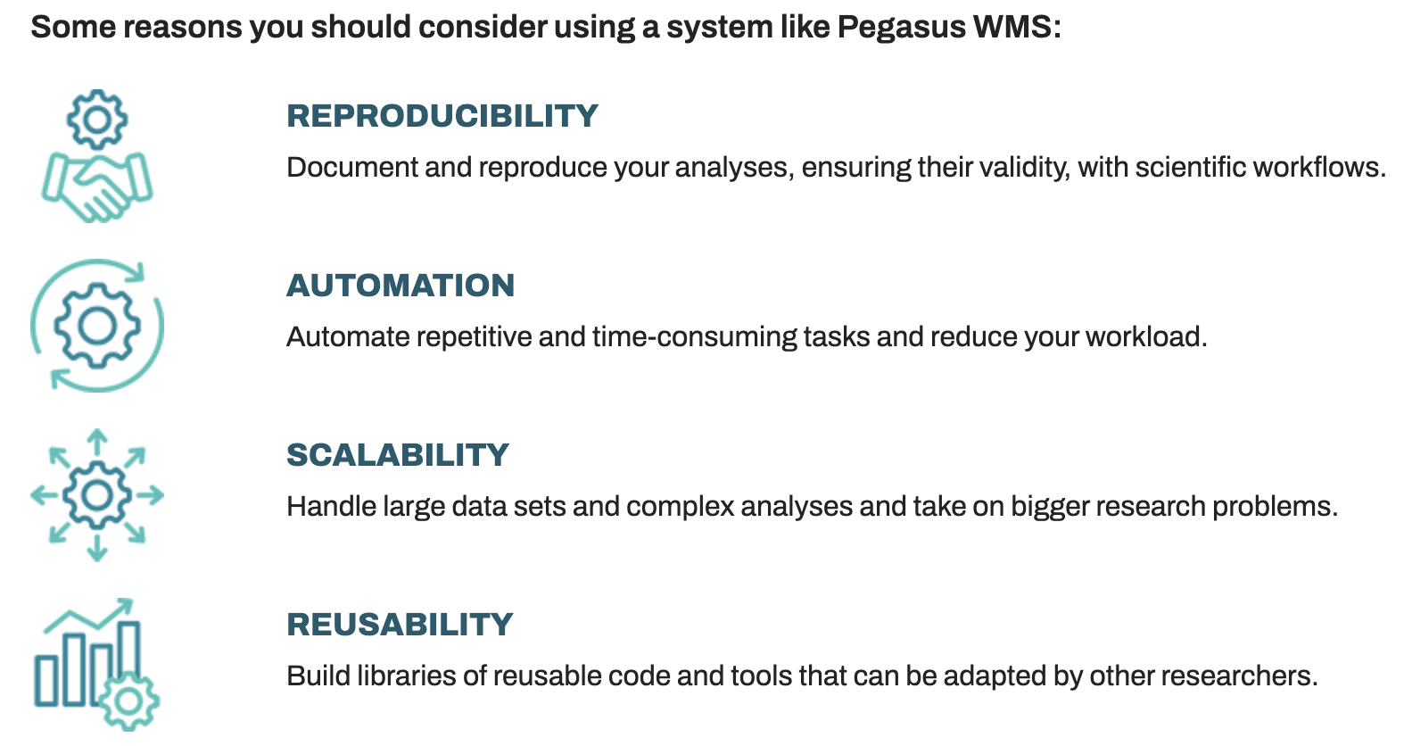
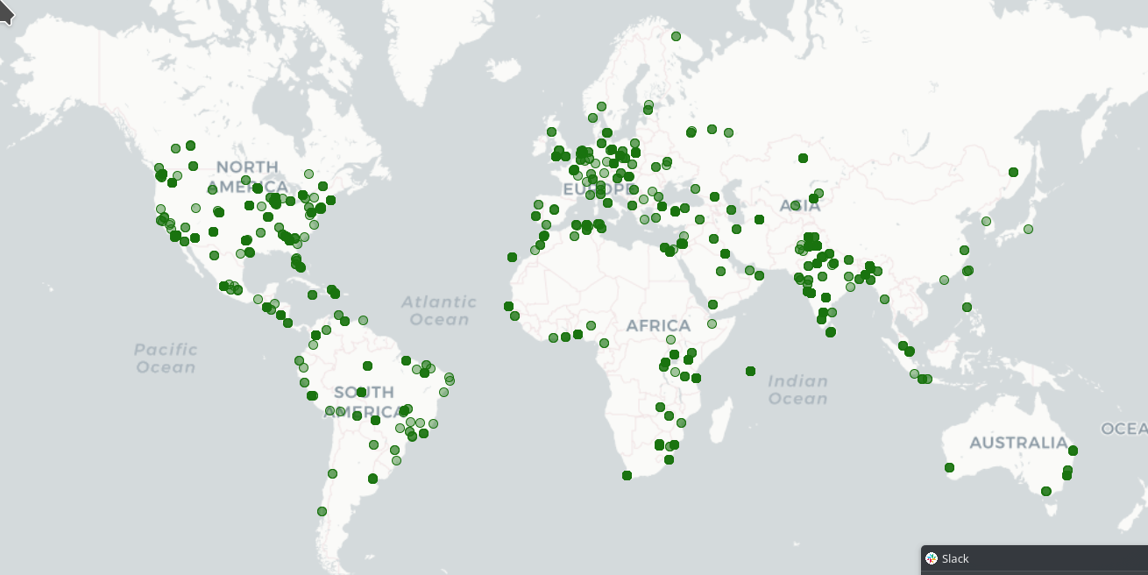
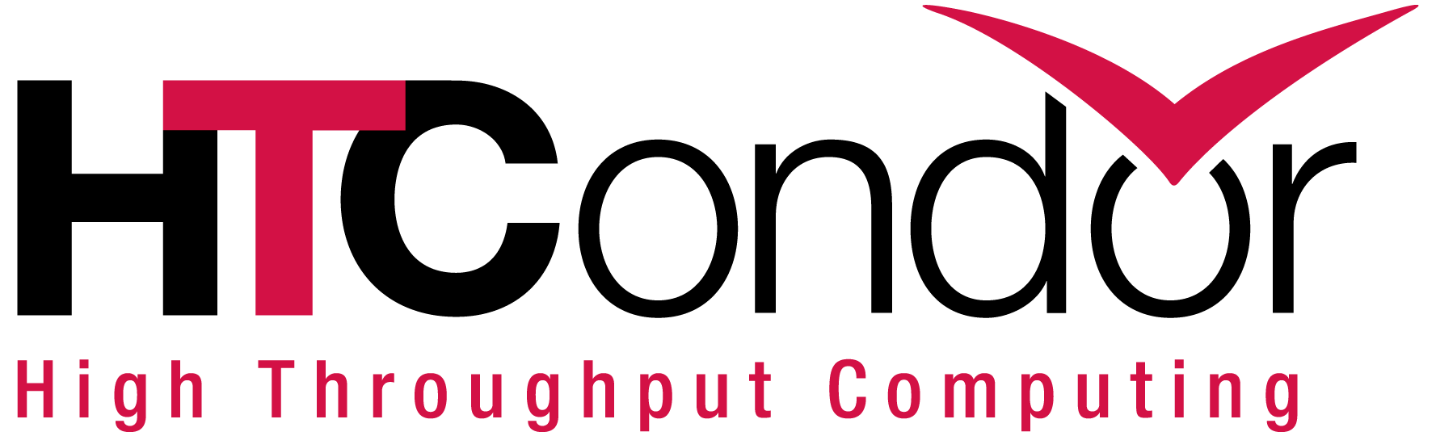


Pegasus: Distributed Workflow Management Research and
Software in Support of Science
Ewa Deelman, Karan Vahi, Mats Rynge, Rajiv Mayani
USC Information Sciences Institute
Pegasus WMS
Pegasus Deployment
Pegasus is a system for mapping and executing abstract application workflows over a range of execution environments.
The same abstract workflow can, at different times, be mapped different execution environments such as ACCESS, PATh, OSG OS Pool, commercial and academic clouds, campus grids, and clusters.
Pegasus can easily scale both the size of the workflow, and the resources that the workflow is distributed over. Pegasus runs workflows ranging from just a few computational tasks up to 1 million.
SUBMIT HOST
Compute Site 1
Input Data Site
Input Sites
F.in
J1
Pegasus Lite
Instance
F.in
Host Input Data
T1
T1
F.int
WN
WN
Staging Site
Data Staging Site
T2
Compute Site n
F.int
Coordinate data
movement for
workflow
F.out
J2
Pegasus Lite
Instance
T2
End to End automatic checksumming of workflow data to ensure data integrity.
Stores static and runtime metadata associated with workflow, files and tasks. Accessible via command line tools and web-based dashboard.
Output Data Site
Output Sites
F.out
Where output data is placed
WN
WN
One or more Compute Sites
Workflow Submit Node
Compute Clusters
Cloud
ACCESS CI
PATh, OSG OS Pool
Real-time Monitoring
Pegasus WMS
HTCondor
Reporting
LEGEND
Debugging
Task flow +
Checksums
Directory
Setup Job
Data
Stageout Job
Check
Integrity Job
J
Pegasus Lite Compute Job
Troubleshooting
Data Flow
Data
Stagein Job
Directory
Cleanup Job
Checksum Generation Job
Worker Node
(WN)
RESTful API
WN
Astronomy and Physics
Applications using Pegasus
NRGR QC
Pegasus powered workflows help detect gravitational waves.
XENONnT workflows for searching Dark Matter.
Event Horizon Telescope for creating images of Black Holes.
Galactic Plane workflow generates mosaics for astronomy surveys.
Seismology
USC CyberShake workflows for seismic hazard analysis of LA basin.
Ecology
Integrated Assessment Models to project impact of policy scenarios
On socio environmental systems.
Predicting Flash Floods in Dallas FortWorth Metroplex.
Producing Titan2D hazard maps that display the probability of a volcanic flow depth reaching a critical height following a premonitory volcanic eruption event.
Microscopy
Investigation of Strong Nuclear Force using gamma ray spectroscopy
Cryo-EM Electroscopy for 3D reconstruction of biological samples
Bioinformatics
Quality control workflows for data submissions to NRGR repository
Genomic Variant Calling Workflow
Others http://pegasus.isi.edu/applications
XENONnT
Two Workflows
LIGO PyCBC
Monte Carlo simulations and the main processing pipeline.
Workflows execute across
Open Science Grid (OSG) &
European Grid Infrastructure
Rucio for data management
CryoEM Processing at USC
MongoDB instance to track science runs and data products.
Southern California Earthquake Center Cybershake
First detection of
black hole
collision
Mix of MPI and single-core jobs, mix of CPU, GPU codes.
Recent CyberShake Study 24.8, which used Pegasus to submit approx. 28,000 jobs across DOE Leadership class systems Frontier and Frontera .
Pegasus automatically managed 1 PB of data and staged 9 million output files totaling 36 TB back to archival to USC.
Supported since 2005: changing CI, x-platform execution
Event Horizon Telescope Bringing Black Holes into Focus
Vermont EPSCoR Integrated Assessment
b Models
Gamma Ray spectroscopy
(
8 telescopes: 5 PB data
60 simulations:
35 TB data
First images of black hole at the center of the M87 galaxy
Improve constraints on Einstein's theory of general relativity by 500x
Access to National CI
ACCESS Pegasus
Support and Downloads
Pegasus is supported workflow tool on important National CI that provides researchers easy and free access to computing services.
ACCESS Pegasus is a hosted workflow management system which allows users to construct, run, and debug workflows from a Jupyter Notebook. Perform simple interactions on the command line. Work across environments and get started quickly with sample workflows using a Python API.
Documentation: https://pegasus.isi.edu/documentation/
Tutorials: Jupyter Notebooks in Docker containers
Email: pegasus-support@isi.edu
Pegasus Users Slack: https://pegasus.isi.edu/contact/
Office Hours: https://pegasus.isi.edu/office-hours/
Downloads & Usage Since 2013
Workflows: 2,700,552 Jobs: 2,028,572,901
Tasks: 7,310,416,875
Release Schedule
Major Release every 9 months. Minor releases every 4 months.
Continuous Integration Testing with GitLab
Download Options
Source Code and Issues publicly hosted on GitHub
Binary packages for Linux and MAC
YUM/APT repositories with RPM/DEB packages
ACCESS CI
https://access-ci.org
ACCESS is a program established and funded by the National Science Foundation to help U.S. based researchers and educators, with or without supporting grants, to utilize the nation’s advanced computing systems and services – at no cost.
Single entry point for over 20 compute, cloud, storage, and networking systems.
PATh and OSG Open Science Pool
https://path-cc.io
The PATh Facility funded by the NSF Office of Advanced Cyberinfrastructure and provides free access to large-scale distributed High Throughput Computing systems for US based open science projects.
Downloads
http://pegasus.isi.edu
Supported by NSF Office of Advanced Cyberinfrastructure Grant: 2138286

